Slide 1
Cyberbullying
Crimes in Modern Society

Slide 2
But first . . . CFAA
Quick reminder
CFAA crime of “Hacking”:
Intent to access a protected computer
Without/exceeding authorization
Cause damage/loss

Slide 3
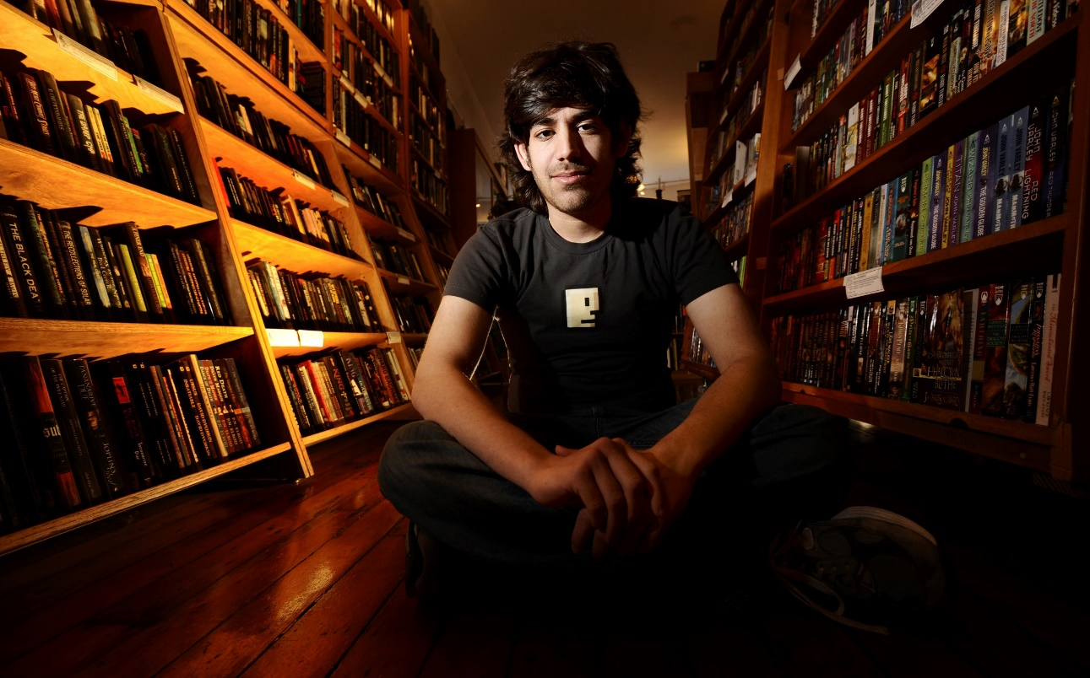
CFF Case Example: Aaron Swartz
Aaron Swartz was an MIT student.
He was also research fellow at Harvard University.

Slide 4
TOS – Aaron Swartz
Harvard gave Swartz a JSTOR account as part of his job.
http://www.jstor.org/
JSTOR is an online database of academic journals and other data
JSTOR owns the copyright to ALL of the manuscripts contained therein

Slide 5
TOS – Aaron Swartz
Swartz downloaded a large number of academic articles from JSTOR through MIT’s network.
Swartz had written a Guerilla Manifesto that said:
“We need to take information . . . make our copies and share them with the world. We need to take stuff that's out of copyright and add it to the archive. We need to buy secret databases and put them on the Web. We need to download scientific journals and upload them to file sharing networks.“
Swartz secretly attached a laptop to MIT’s computer network allowing him to "rapidly download an extraordinary volume of articles from JSTOR.“
Prosecutors in the case said Swartz acted with the intention of making the papers available on P2P file-sharing sites.
However, Swartz did not do so and returned all the files to JSTOR after he was caught.

Slide 6
TOS – Aaron Swartz
Swartz was indicted on 11 charges of violating the CFAA, facing 35 years in jail.
The Manifesto played a key role in the prosecutor’s decision.
But Swartz was never convicted. He committed suicide in 2013.

Slide 7
Cyberbullying
Really this time!

Slide 8
Definitions
What is bullying?
Bullying is the use of force, threat, or coercion to abuse, intimidate, or aggressively dominate others. The behavior is often repeated and habitual. One essential prerequisite is the perception, by the bully or by others, of an imbalance of social or physical power, which distinguishes bullying from conflict.
What is Cyberbullying?
the use of electronic communications to bully a person

Slide 9
Definitions - Traditional
Harassment – an individual or group with no legitimate purpose causes great emotional distress to a person.
Stalking – perpetrator relentlessly pursues the victim
Bullying – aggressive behavior that is intentional and involves imbalance of power or strength.

Slide 10
Definitions – Cyber
Cyber- harassment – an individual or group with no legitimate purpose uses a form of electronic communications as a mean to cause great emotional distress to a person.
Cyber-Stalking – perpetrator relentlessly pursues the victim online, likely in combination with an offline attack.
Cyber-bullying – aggressive behavior that is intentional and involves imbalance of power or strength, in electronic form.

Slide 11
Bullying Statistics
United States
28% of students report being bullied
15% cyberbullied
Korea
30%+ bullied
17% cyberbullied

Slide 12
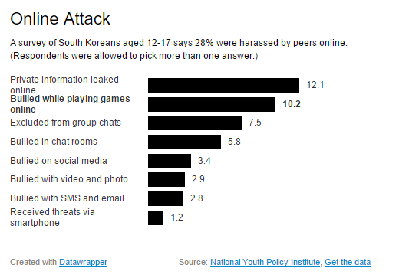

Slide 13
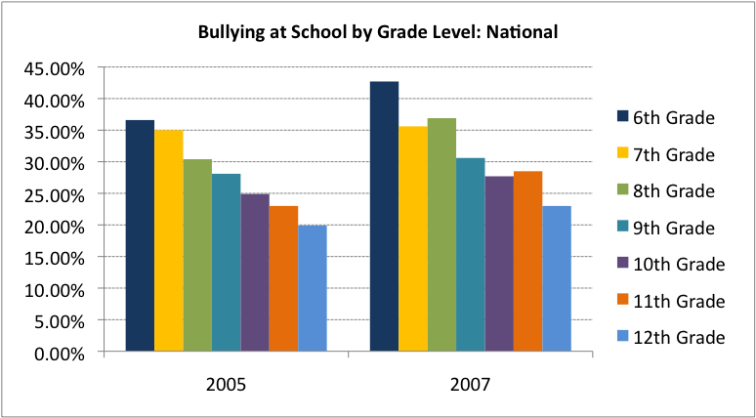

Slide 14
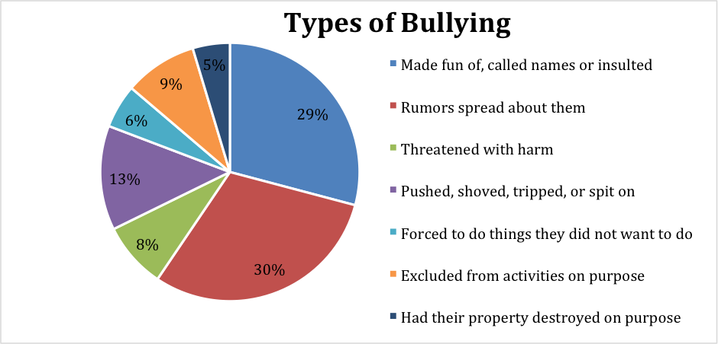

Slide 15

The Case of Megan Meier
In October 2006, Megan Meier (14 years old) committed suicide.
The suicide was caused by an elaborate hoax led by Megan’s classmate’s 47 year-old mother, Lori Drew

Slide 16
The Case of Megan Meier
The Hoax:
Lori set up a fake “MySpace” web page of a teenage boy names ‘Josh Evans.’
What the heck is myspace???
Lori, her daughter (and others) communicated to Megan, pretending to be ‘Josh.’

Slide 17
The Case of Megan Meier
One day, discussion with classmates and ‘Josh’ turned into insults.
‘Josh’’s last message to Megan was:
“You’re a shitty person, and the world would be a better place without you in it.”
Then Megan committed suicide.

Slide 18
The Case of Megan Meier
At the time, Missouri (State) law did not have any provisions for cyber-harassment or cyber-bullying.
Nor was there any Federal Law related to cyber-bullying

Slide 19
Case against Lori Drew
Nevertheless, Federal Prosecutors charged Lori Drew with federal crimes:
Drew was charged with four counts for violating the CFAA
How can cyberbullying be considered hacking?

Slide 20
CFAA - Elements
Accessing a Protected Computer?
Yes – In this case the protected computer is the Server hosting MySpace
Without Authorization/Exceeding Authorization?
Lori had Authorization to use MySpace however she exceeded that Authorization
How? By creating a fake account/using account to violate MySpace’s “Terms of Service Agreement” (TOS)
Causing Loss?
Sure, loss of life

Slide 21
Case against Lori Drew
Lori Drew was ultimately acquitted of all charges.
Basing unauthorized access on the Terms of Service violation was too vague.

Slide 22
Legal Remedies
The laws on Cyber-Bullying and cyber-harassment are still in development.
Means of laws can take two approaches:
Use Traditional Means
Develop new criminal laws specific to cyber-harassment/bullying
Aprox. Twenty states have changes laws to try to address cyber bullying.

Slide 23
Legal Remedies
Traditional Means:
Defamation (Libel)
CFAA (perhaps?)
Traditional Criminal Harassment Law
Harassment
Stalking
Violation of invasion of Privacy
Civil Rights laws

Slide 24
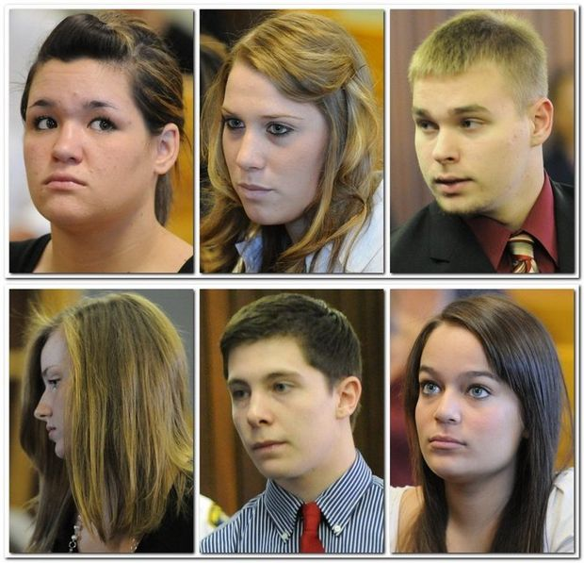
Traditional Remedy – Example
Phoebe Prince (15) committed suicide in 2010.
She had been “persistently” bullied by classmates while at school.
For example:
A classmate followed Prince home from school in a friend's car, threw an empty can at her, and yelled an insult
Prosecutor charged 6 students
Criminal Harassment
Assault with a deadly weapon
All of the students plead guilty to lesser charges

Slide 25
Legal Remedies
New Means:
Laws related to bullying (and cyberbullying)
But… usually related to school policy, not criminalizing individual conduct
Laws to criminalize the act.
Many states have updated their Criminal Harassment laws to include cyber-harassment.
44 States have laws on Bullying (30 include electronic harassment).
http://www.ncleg.net/enactedlegislation/statutes/html/bysection/chapter_14/gs_14-458.1.html

Slide 26
Legal Remedies
Proposed Federal Law (2009)
“Whoever transmits in interstate or foreign commerce any communication, with the intent to coerce, intimidate, harass, or cause substantial emotional distress to a person, using electronic means to support severe, repeated, and hostile behavior, shall be fined under this title or imprisoned not more than two years, or both.”

